Slide 1
Splunk Basics

Slide 2
CONTENTS
01
Consumer definition
Pg. No 03
02
Product Categories
Pg. No 04
03
Components of Splunk
Pg. No 05
04
Deployment Models
Pg. No 06
05
Splunk Licensing
Pg. No 07
06
Search Methods
Pg. No 08

Slide 3
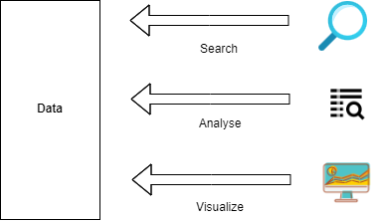
What is Splunk?
Spunk: Splunk is a tool that is used to search, analyze, and visualize machine data. Splunk processes and extracts machine data to a human-readable format.
Examples of machine data: machine data is generated by a CPU running a webserver, IoT devices, logs from mobile apps, etc.
Why analyze of machine data is important?
Machine data are extremely important to understand, monitor, and optimize the performance of the machines.

Slide 4
Product Categories
Product Categories:
Splunk is available in three different product categories-
Splunk Enterprise
Splunk Cloud
Splunk Light

Slide 5
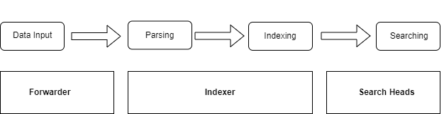
Components of Splunk
Forwarder- Forwards raw data to the other parts of the deployment.
Indexer-Takes raw data from forwarders, turn it into events, and places the results into an index, which is stored in the bucket.
Search head- handles search requests and consolidates the search results and gives it back to the user

Slide 6
Deployment Models
Departmental Deployment
A single search head/indexer
Up to 10 forwarder
Appropriate for up to 10 users
Small Enterprise Deployment
A single search head
Two to three indexers
100 to 200 forwarders
Large Enterprise Deployment
Search head cluster
Lots of indexers
Thousands of forwarders
A deployer

Slide 7
Splunk Licensing
Enterprise Trial
Downloads and install with product
Valid for 60 days
Free License
Disables a bunch of features like alert, clustering, etc.
Forwarder License
Allows a Splunk instance to be installed as a heavy forwarder
Enterprise
Purchased from a Splunk sales representative
Daily indexing volume based on how much you pay.

Slide 8
Search Modes
The Search App has three modes:
Fast
No field discovery except the default metadata fields.
Use if you know exactly which fields you need and can specify them in the search string.
Smart
Returns the best results for whatever search you are running.
Verbose
Discover all fields it can.
Use if you are not sure what fields you will want to report on.

Slide 9
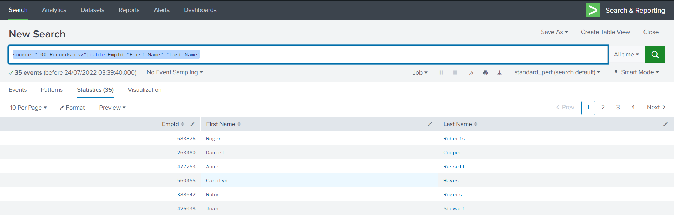
Table Command
The table command returns a table that is formed by only the fields that you specify in the arguments.
Syntax- table <field_list>

Slide 10


Rename Command
The rename command is used to rename one or more fields.
Syntax- table <field> AS <new_field_name>

Slide 11
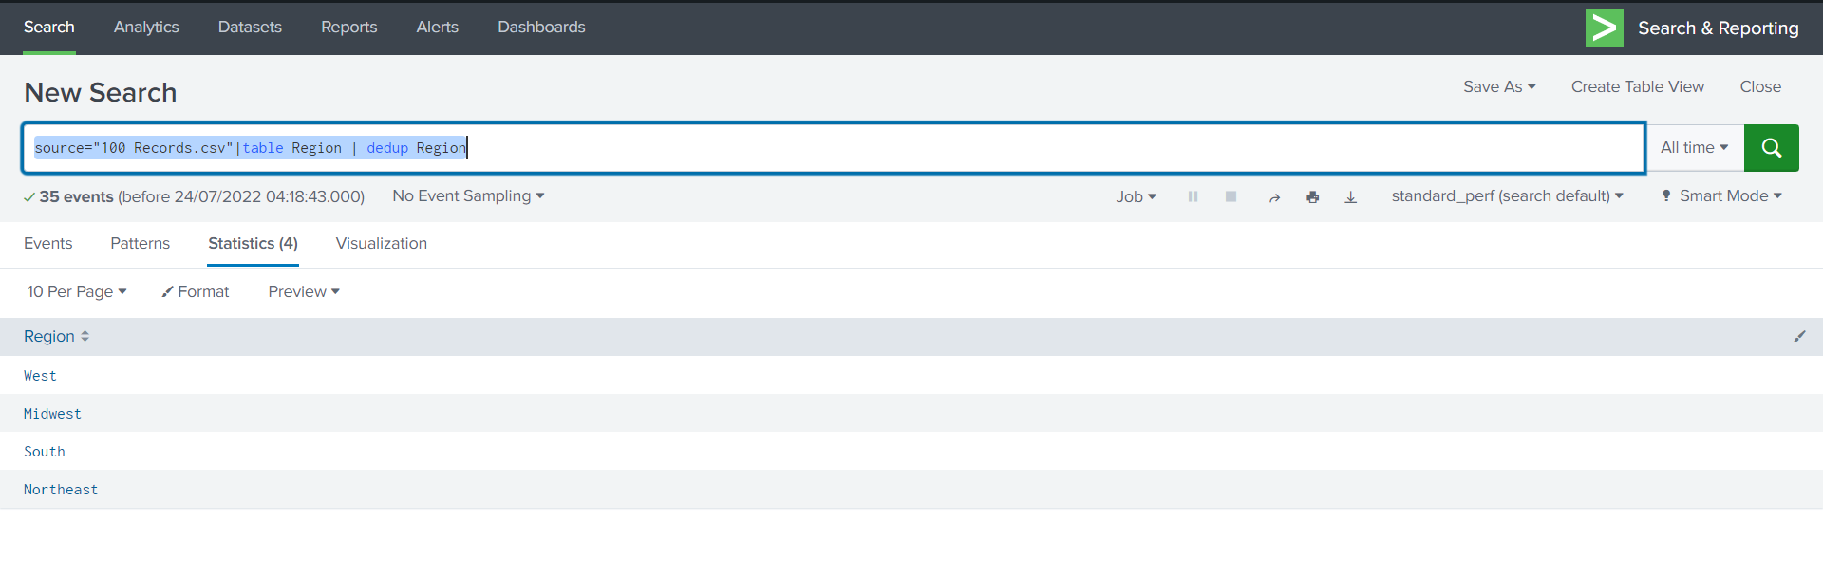
Dedup Command
Removes the events that contain an identical combination of values for the specified fields.
Syntax- dedup <field_list>

Slide 12
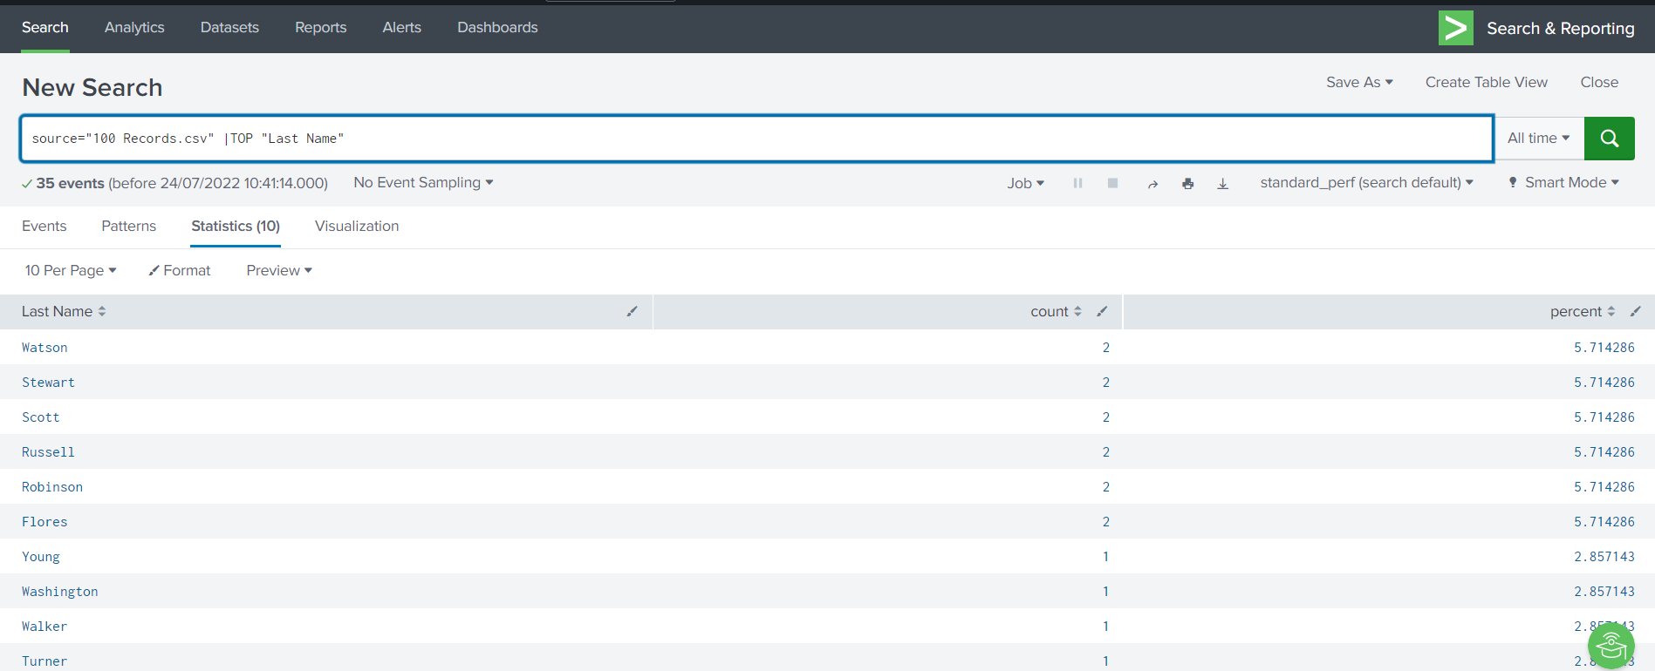
Top Command
Returns the most common values of a given field.
Syntax- top <field>

Slide 13
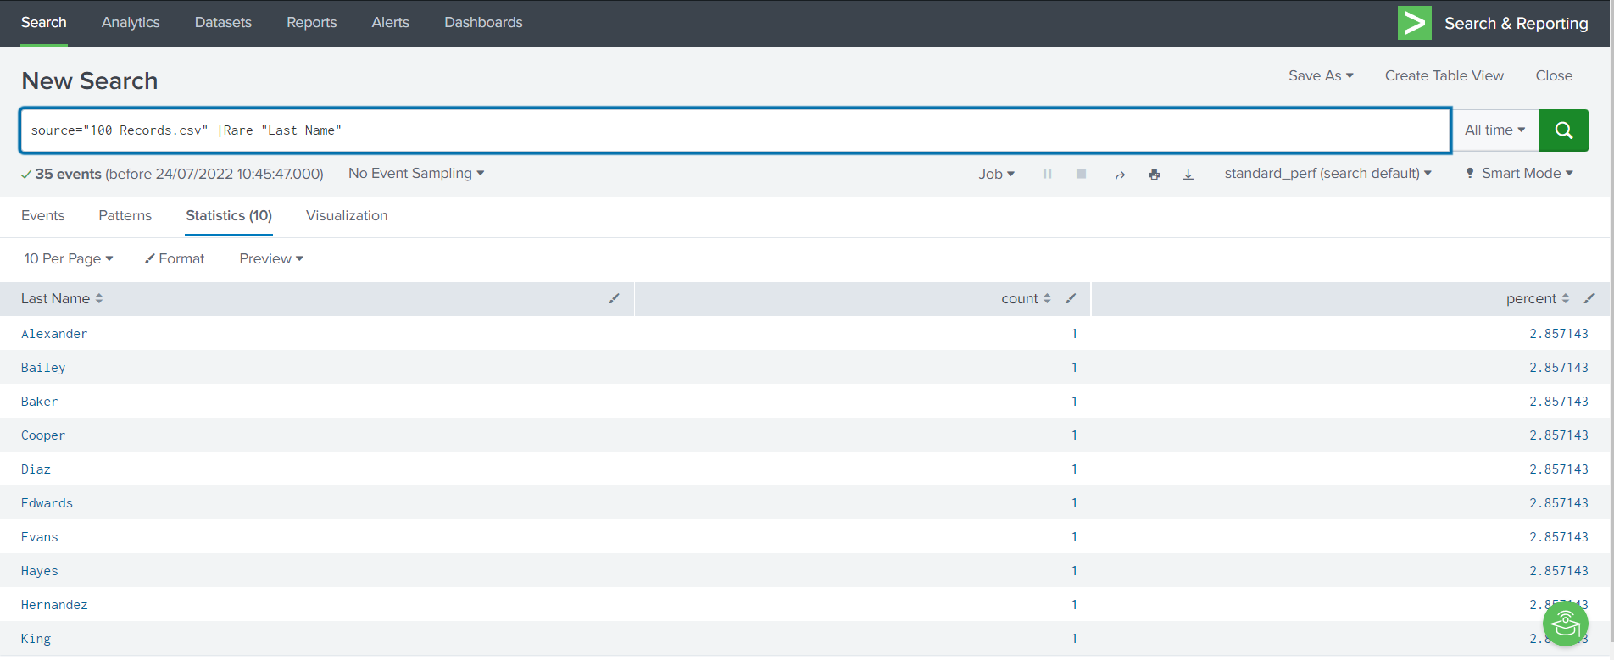
Rare Command
Returns the least common values of a field
Syntax- rare <field>

Slide 14
Search Intermediate-Stats
Syntax- stats <function(field)> [BY <field(s)>]
Some common functions-count, avg, max, min, sum, stdev, values, list

Slide 15
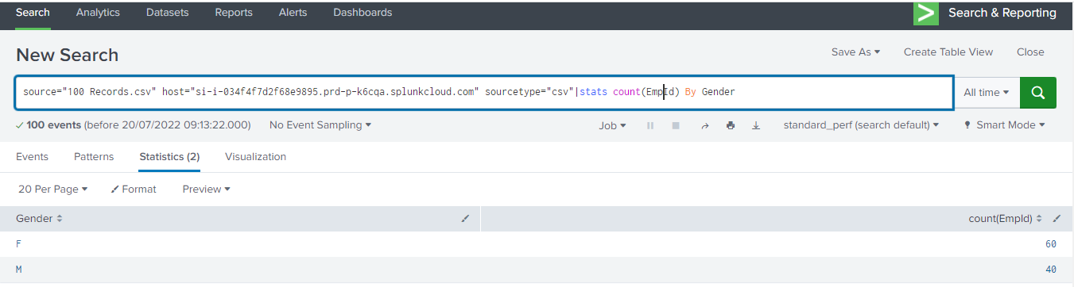
Example-Stats -COUNT

Slide 16
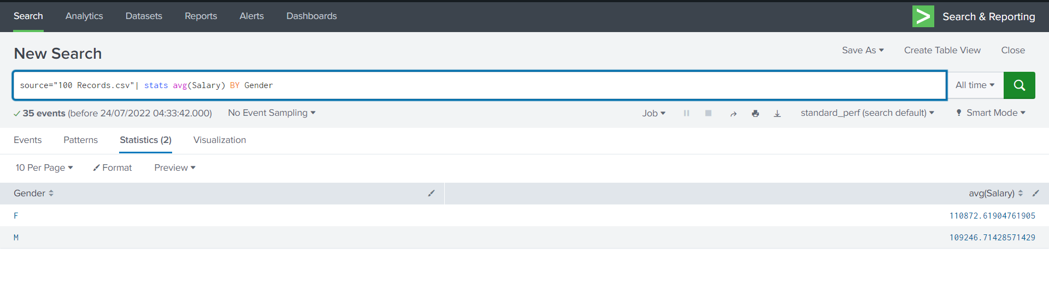
Example-Stats-AVG

Slide 17
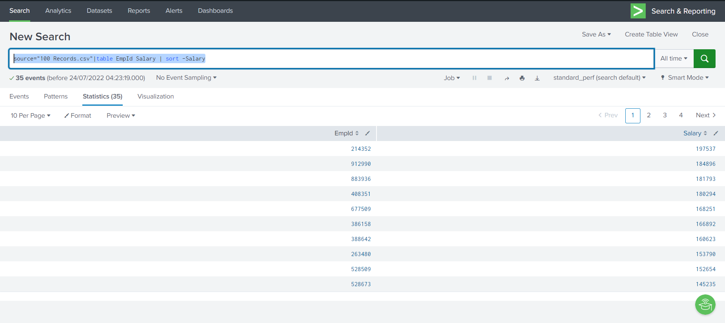
Sort Command (descending)

Slide 18
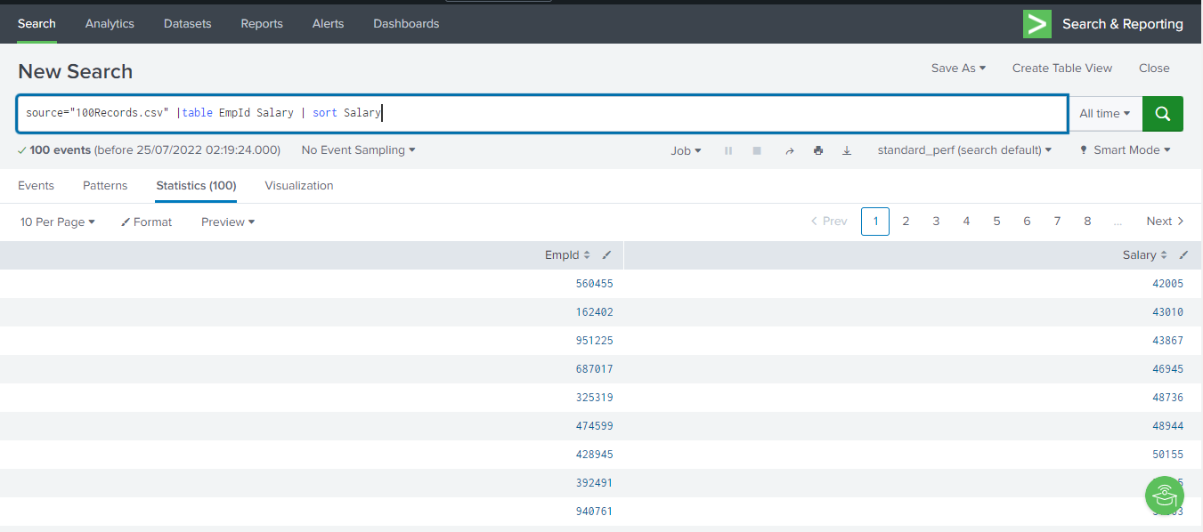
Sort Command (ascending)

Slide 19
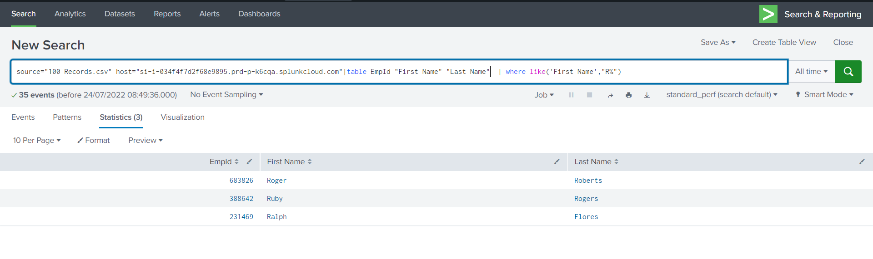
String Matching
List of Employees whose name starts with ‘R’

Slide 20
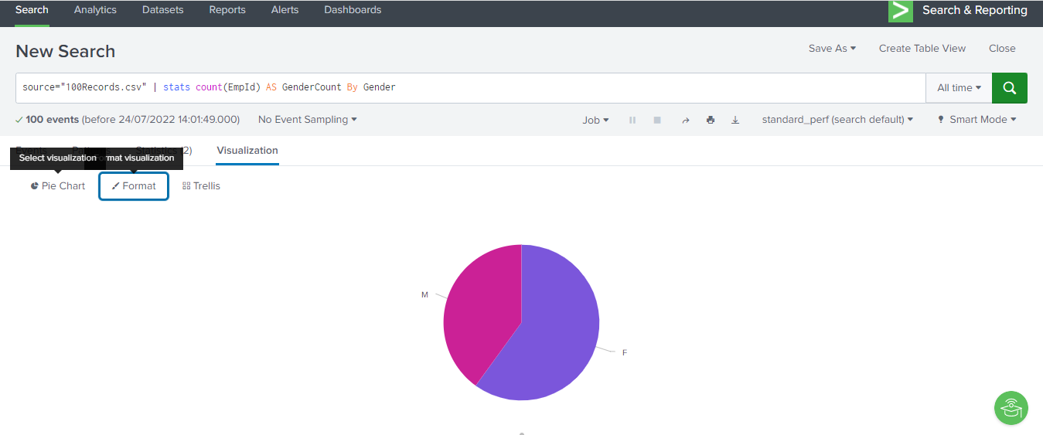
Example-Stats-Visualization

